Slide 1
Research Design & Methods
Unit 3

Slide 2


Slide 3
Research Design
The formidable problem that follows the task of defining the research problem is the preparation of the design of the research project, popularly known as the “research design”.
Decisions regarding what, where, when, how much, by what means concerning an inquiry or a research study constitute a research design.
“A research design is the arrangement of conditions for collection and analysis of data in a manner that aims to combine relevance to the research purpose with economy in procedure.”

Slide 4
Research Design
The research design is the conceptual structure within which research is conducted; it constitutes the blueprint for the collection, measurement and analysis of data.
As such the design includes an outline of what the researcher will do from writing the hypothesis and its operational implications to the final analysis of data.

Slide 5
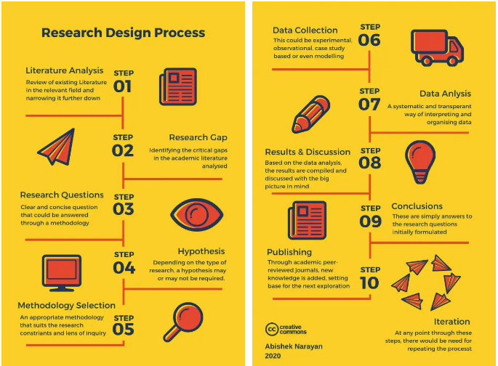

Slide 6
The overall research design into can be divided into the following parts:
(a) the sampling design which deals with the method of selecting items to be observed for they given study;
(b) the observational design which relates to the conditions under which the observations are to be made;
(c) the statistical design which concerns with the question of how many items are to be observed and how the information and data gathered are to be analysed; and
(d) the operational design which deals with the techniques by which the procedures specified in the sampling, statistical and observational designs can be carried out.

Slide 7
The important features of a research design are:
(i) It is a plan that specifies the sources and types of information relevant to the research problem.
(ii) It is a strategy specifying which approach will be used for gathering and analysing the data.
(iii) It also includes the time and cost budgets since most studies are done under these two constraints.

Slide 8
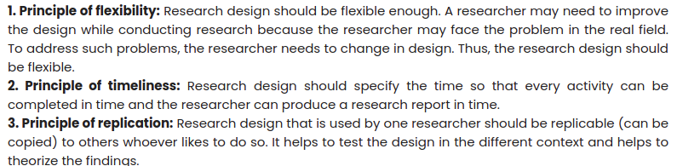
Research Design- basic principles

Slide 9
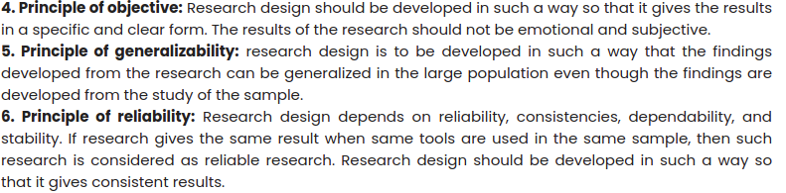
contd…

Slide 10
contd…

Slide 11
NEED FOR RESEARCH DESIGN
Research design is needed because it facilitates the smooth sailing of the various research operations, thereby making research as efficient as possible yielding maximal information with minimal expenditure of effort, time and money.
We need a research design or a plan in advance of data collection and analysis for our research project.
Preparation of the research design should be done with great care as any error in it may upset the entire project.

Slide 12
contd…
The design helps the researcher to organize his ideas in a form whereby it will be possible for him to look for flaws and inadequacies.
Such a design can even be given to others for their comments and critical evaluation.
In the absence of such a course of action, it will be difficult for the critic to provide a comprehensive review of the proposed study.

Slide 13
FEATURES OF A GOOD DESIGN
Generally, the design which minimises bias and maximises the reliability of the data collected and analysed is considered a good design.
The design which gives the smallest experimental error is supposed to be the best design in many investigations.
Similarly, a design which yields maximal information and provides an opportunity for considering many different aspects of a problem is considered most appropriate and efficient design in respect of many research problems.
Thus, the question of good design is related to the purpose or objective of the research problem and also with the nature of the problem to be studied.

Slide 14
contd…
A research design appropriate for a particular research problem, usually involves the consideration of the following factors:
the means of obtaining information;
the availability and skills of the researcher and his staff, if any;
the objective of the problem to be studied;
the nature of the problem to be studied; and
the availability of time and money for the research work.

Slide 15
IMPORTANT CONCEPTS RELATING TO RESEARCH DESIGN
1. Dependent and independent variables:
A concept which can take on different quantitative values is called a variable. (Ex: concepts like weight, height, income)
Qualitative phenomena (or the attributes) are also quantified on the basis of the presence or absence of the concerning attribute(s). Phenomena which can take on quantitatively different values even in decimal points are called ‘continuous variables’. (Ex: Age)
But all variables are not continuous. If they can only be expressed in integer values, they are non-continuous variables or in statistical language ‘discrete variables’.
If one variable depends upon or is a consequence of the other variable, it is termed as a dependent variable, and the variable that is antecedent to the dependent variable is termed as an independent variable.

Slide 16
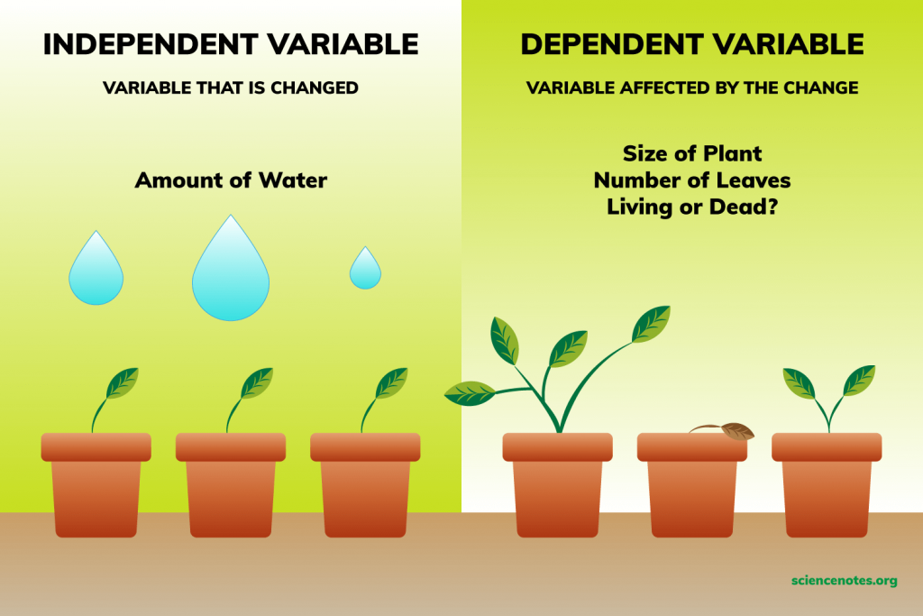

Slide 17
contd…
2. Extraneous variable:
Independent variables that are not related to the purpose of the study, but may affect the dependent variable are termed as extraneous variables.
Whatever effect is noticed on dependent variable as a result of extraneous variable(s) is technically described as an ‘experimental error’.
Ex: test the hypothesis that there is a relationship between children’s gains in social studies achievement and their self-concepts.

Slide 18
contd…
3. Control:
One important characteristic of a good research design is to minimise the influence or effect of extraneous variable(s).
The technical term ‘control’ is used when we design the study minimising the effects of extraneous independent variables. In experimental researches, the term ‘control’ is used to refer to restrain experimental conditions.

Slide 19
4. Confounded relationship:
When the dependent variable is not free from the influence of extraneous variable(s), the relationship between the dependent and independent variables is said to be confounded by an extraneous variable(s).

Slide 20
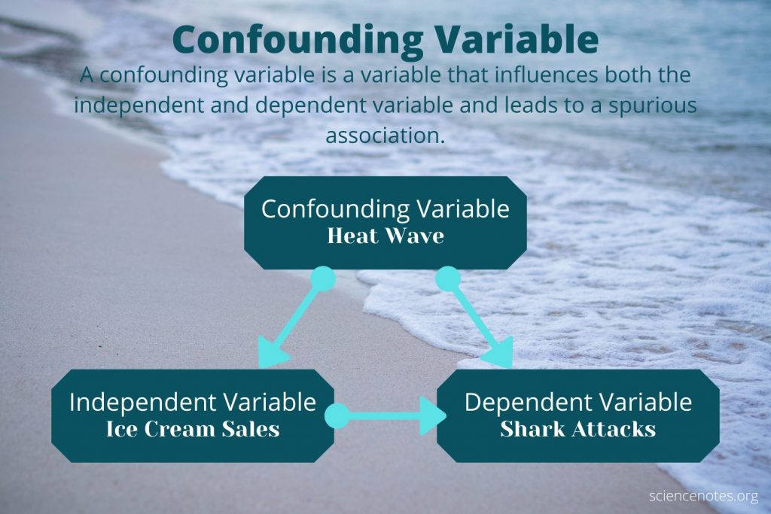

Slide 21
5. Research hypothesis:
When a prediction or a hypothesised relationship is to be tested by scientific methods, it is termed as research hypothesis.
The research hypothesis is a predictive statement that relates an independent variable to a dependent variable.
Usually a research hypothesis must contain, at least, one independent and one dependent variable.
Predictive statements which are not to be objectively verified or the relationships that are assumed but not to be tested, are not termed research hypotheses.
Ex: “Smoking is a prominent cause of lung cancer." The dependent variable, lung cancer, is dependent on the independent variable, smoking.

Slide 22
6. Experimental and non-experimental hypothesis-testing research:
When the purpose of research is to test a research hypothesis, it is termed as hypothesis-testing research..
Research in which the independent variable is manipulated is termed ‘experimental hypothesis-testing research’ and a research in which an independent variable is not manipulated is called ‘non-experimental hypothesis-testing research’.
Ex: "If I do not study, then I will fail the test."

Slide 23
7. Experimental and control groups:
In an experimental hypothesis-testing research when a group is exposed to usual conditions, it is termed a ‘control group’, but when the group is exposed to some novel or special condition, it is termed an ‘experimental group’.

Slide 24
8. Treatments:
The different conditions under which experimental and control groups are put are usually referred to as ‘treatments’.
Ex: a medical doctor can prescribe three different types of drugs to three different groups of patients respectively to see the effectiveness of each drug.
Ex: A teacher, A farmer etc.

Slide 25
9. Experiment:
The process of examining the truth of a statistical hypothesis, relating to some research problem, is known as an experiment.
For example, we can conduct an experiment to examine the usefulness of a certain newly developed drug.
Experiments can be of two types viz., absolute experiment and comparative experiment. If we want to determine the impact of a fertilizer on the yield of a crop, it is a case of absolute experiment; but if we want to determine the impact of one fertilizer as compared to the impact of some other fertilizer, our experiment then will be termed as a comparative experiment. Often, we undertake comparative experiments when we talk of designs of experiments.

Slide 26
10. Experimental unit(s):
The predetermined plots or the blocks, where different treatments are used, are known as experimental units. Such experimental units must be selected (defined) very carefully.

Slide 27
SAMPLE DESIGN
CENSUS AND SAMPLE SURVEY
All items in any field of inquiry constitute a ‘Universe’ or ‘Population.’ A complete enumeration of all items in the ‘population’ is known as a census inquiry.
When field studies are undertaken in practical life, considerations of time and cost almost invariably lead to a selection of respondents i.e., selection of only a few items.
The respondents selected should be as representative of the total population as possible in order to produce a miniature cross-section.
The selected respondents constitute what is technically called a ‘sample’ and the selection process is called ‘sampling technique.’ The survey so conducted is known as ‘sample survey’.

Slide 28
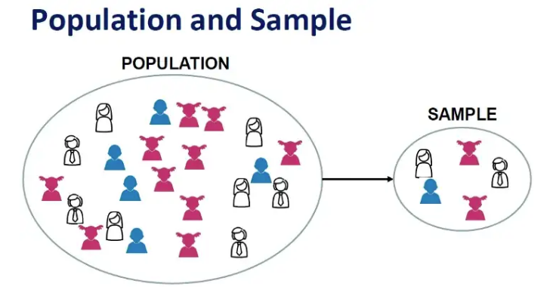

Slide 29
SAMPLE DESIGN
A sample design is a definite plan for obtaining a sample from a given population.
It refers to the technique or the procedure the researcher would adopt in selecting items for the sample.
Sample design is determined before data are collected.

Slide 30
STEPS IN SAMPLE DESIGN
Objective:
This is the first step in sampling design where-in the objectives of survey should be clear.
The researchers of the survey should confirm that the objectives are in accordance with respect to money, manpower and time limitations available for survey.

Slide 31
STEPS IN SAMPLE DESIGN
2. Population:
In order to meet the objectives of the study, what should be the population?
This question should be answered in the second step. The population should be clearly defined.

Slide 32
STEPS IN SAMPLE DESIGN
3. Sampling Units & Frame:
A decision has to be taken concerning a sampling unit before selecting sample.
Sampling unit may be a geographical one such as state, district, village, etc., or a construction unit such as house, flat, etc., or it may be a social unit such as family, club, school, etc., or it may be an individual.
The researcher will have to decide one or more of such units that he has to select for his study.
The list of sampling units is called a ‘frame’ or ‘sampling frame’.

Slide 33
STEPS IN SAMPLE DESIGN
4. Size of sample:
This refers to the number of items to be selected from the universe to constitute a sample. This a major problem before a researcher.
The size of sample should neither be excessively large, nor too small. It should be optimum.
An optimum sample is one which fulfills the requirements of efficiency, representativeness, reliability and flexibility.
The parameters of interest in a research study must be kept in view, while deciding the size of the sample.
Costs too dictate the size of sample that we can draw. As such, budgetary constraint must be taken into consideration when we decide the sample size.

Slide 34
STEPS IN SAMPLE DESIGN
5. Parameters of interest:
Statistical constants of the population are called as parameters.
Ex: Population mean, Population proportion.
When we do census survey we get the actual value of parameters.
When we do sample survey we get estimates of unknown population parameters in place of their actual values.
In determining the sample design, one must consider the question of the specific population parameters which are of interest.
For instance, we may be interested in estimating the proportion of persons with some characteristic in the population, or we may be interested in knowing some average or the other measure concerning the population.

Slide 35
STEPS IN SAMPLE DESIGN
6. Data Collection:
No irrelevant information should be collected and no essential information should be discarded.
The objective of the survey has be very clear in the mind of the researcher.

Slide 36
STEPS IN SAMPLE DESIGN
7. Non – respondents:
Sometimes data may not be collected for all the sampled units. This non-respondents tends to change the results.
The reason for non-respondents must be recorded and handled carefully by the investigator.

Slide 37
STEPS IN SAMPLE DESIGN
8. Selection of proper sampling design:
The researcher must decide the type of sample he will use i.e., he must decide about the technique to be used in selecting the items for the sample.
In fact, this technique or procedure stands for the sample design itself.
There are several sample designs out of which the researcher must choose one for his study.
Obviously, he must select that design which, for a given sample size and for a given cost, has a smaller sampling error.

Slide 38
STEPS IN SAMPLE DESIGN
9. Organizing field work:
The success of a survey depends on the reliable filed work.
There should be efficient supervisory staff and trained personnel's for the field work.

Slide 39
STEPS IN SAMPLE DESIGN
10. Pilot survey:
It is always helpful to try out the research design on a small scale before going to the field. This is called ‘pilot survey’ or ‘pretest’.
It might also give the better idea of the practical problems and troubles.
Ex: Mock tests

Slide 40
STEPS IN SAMPLE DESIGN
11. Budgetary constraints:
Cost considerations, from practical point of view, have a major impact upon decisions relating to not only the size of the sample but also to the type of sample.
This fact can even lead to the use of a non-probability sample.

Slide 41
CHARACTERISTICS OF A GOOD SAMPLE DESIGN
Sample design must result in a truly representative sample.
Sample design must be such which results in a small sampling error/ free from error.
Sample design must be viable in the context of funds available for the research study.
Sample design must be such so that systematic bias can be controlled in a better way.
Sample should be such that the results of the sample study can be applied, in general, for the universe with a reasonable level of confidence.

Slide 42
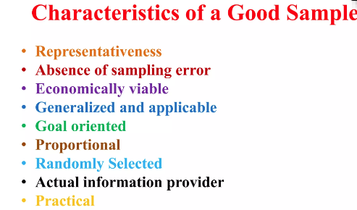

Slide 43
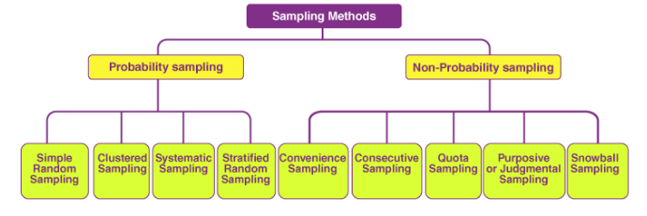
TYPES OF SAMPLE DESIGNS

Slide 44
Non- probability Sampling
Non-probability sampling is that sampling procedure which does not afford any basis for estimating the probability that each item in the population has of being included in the sample.
Non-probability sampling is also known by different names such as deliberate sampling, purposive sampling and judgement sampling.
In this type of sampling, items for the sample are selected deliberately by the researcher; his choice concerning the items remains supreme.
Ex: if economic conditions of people living in a state are to be studied, a few towns and villages may be purposively selected for intensive study on the principle that they can be representative of the entire state.
Thus, the judgement of the organizers of the study plays an important part in this sampling design.

Slide 45
Non- probability Sampling
Example: Quota sampling is also an example of non-probability sampling.
Under quota sampling the interviewers are simply given quotas to be filled from the different strata, with some restrictions on how they are to be filled.
In other words, the actual selection of the items for the sample is left to the interviewer’s discretion. This type of sampling is very convenient and is relatively inexpensive.

Slide 46
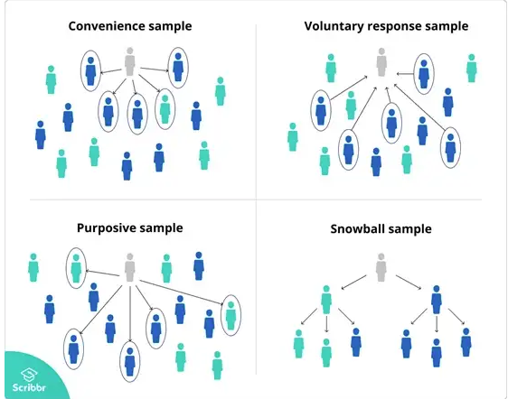

Slide 47
Probability Sampling
Probability sampling is also known as ‘random sampling’ or ‘chance sampling’.
Under this sampling design, every item of the universe has an equal chance of inclusion in the sample.
Ex:, a lottery method/ Lucky draw
Random sampling ensures the law of Statistical Regularity which states that if on an average the sample chosen is a random one, the sample will have the same composition and characteristics as the universe.
This is the reason why random sampling is considered as the best technique of selecting a representative sample.

Slide 48
Simple random sampling
In a simple random sample, every member of the population has an equal chance of being selected. Your sampling frame should include the whole population.
To conduct this type of sampling, you can use tools like random number generators or other techniques that are based entirely on chance.
Ex: You want to select a simple random sample of 1000 employees of a social media marketing company. You assign a number to every employee in the company database from 1 to 1000, and use a random number generator to select 100 numbers.

Slide 49
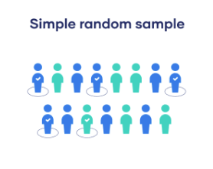

Slide 50
Systematic sampling
Systematic sampling is similar to simple random sampling, but it is usually slightly easier to conduct.
Every member of the population is listed with a number, but instead of randomly generating numbers, individuals are chosen at regular intervals.
Example: All employees of the company are listed in alphabetical order. From the first 10 numbers, you randomly select a starting point: number 6. From number 6 onwards, every 10th person on the list is selected (6, 16, 26, 36, and so on), and you end up with a sample of 100 people.

Slide 51
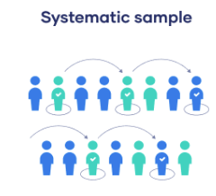

Slide 52
Stratified sampling
Stratified sampling involves dividing the population into subpopulations that may differ in important ways.
To use this sampling method, you divide the population into subgroups (called strata) based on the relevant characteristic (e.g., gender identity, age range, income bracket, job role).

Slide 53
Stratified sampling
Based on the overall proportions of the population, you calculate how many people should be sampled from each subgroup. Then you use random or systematic sampling to select a sample from each subgroup.
Ex: The company has 800 female employees and 200 male employees. You want to ensure that the sample reflects the gender balance of the company, so you sort the population into two strata based on gender. Then you use random sampling on each group, selecting 80 women and 20 men, which gives you a representative sample of 100 people.

Slide 54
Cluster sampling
Cluster sampling also involves dividing the population into subgroups, but each subgroup should have similar characteristics to the whole sample. Instead of sampling individuals from each subgroup, you randomly select entire subgroups.
If it is practically possible, you might include every individual from each sampled cluster. If the clusters themselves are large, you can also sample individuals from within each cluster using one of the techniques above. This is called multistage sampling.

Slide 55
Cluster sampling
This method is good for dealing with large and dispersed populations,
It’s difficult to guarantee that the sampled clusters are really representative of the whole population.
Ex: The company has offices in 10 cities across the country (all with roughly the same number of employees in similar roles). You don’t have the capacity to travel to every office to collect your data, so you use random sampling to select 3 offices – these are your clusters.

Slide 56
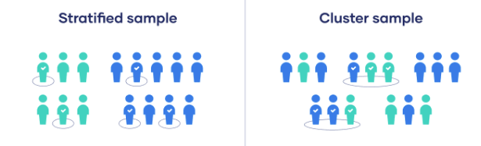

Slide 57
MEASUREMENT AND SCALING TECHNIQUES
Technically speaking, measurement is a process of mapping aspects of a domain onto other aspects of a range according to some rule of correspondence.
In measuring, we devise some form of scale in the range and then transform or map the properties of objects from the domain onto this scale.
Types of Data
Nominal
Ordinal
Interval
Ratio

